Slide 1

ROAD MAP & DREAM ROLE
Submitted By: -
Ekhlakh Ahmad.
Reg No.: - 12209166.
Submitted To: -
Prof. Sarabjit Kumar

Slide 2
Cohort identified for the Dream Job
Software engineer
I am good in program solving.
My logical ability is good.
Computer application is my academic background.
I am quick learner.

Slide 3
Companies identified for the cohort (product Based)
Software engineer in AMAZON.
Software engineer in GOOGLE.
Software engineer in FLIPKART.
Software engineer in APPLE.
All are product based mnc those have many works related to software development.

Slide 4
Role Model Identified from the company

Slide 5
Connection establishment with company
Connection established with AMAZON through LinkedIn.
Connection established with GOOGLE through LinkedIn.
Connection established with APPLE through LinkedIn.
Connection established with FLIPKART through LinkedIn.

Slide 6
Technology you aligned for the Dream Company & Cohort
PYTHON, C, C++, SQL, JAVA: -
Programming language, such as Python, C/C++, SQL, and Java, with Python being the most common coding language required in software development roles.
BIG DATA: -
Big data analytics provides a new way of analysing information, one that can uncover new insight and generate useful for requirement gathering.

Slide 7
Certification/ Internships you have planned for the Cohort
Full stack web development. It will help me for learning the latest technologies and frame work in JavaScript.
Certification in C++. It will help me to make command n a good language.
Certification in JAVA. It will help me to understand the run time environment in company.

Slide 8
Projects you have planned for the Cohort
I planned a big project in C++. It will help to improve my skill.
I planned many projects on (C++, JAVA, WEB Development).
It will improve own skills.

Slide 9
Association with Communities other bodies
LinkedIn Account: EKHLAKH AHMAD
linkedin.com/in/ekhlakh-ahmad
Github Account: EKHLAKH AHMAD
github.com/ekhlakhahmad

Slide 10
Participation in Events & Competitions
International conference on recent advances in computing sciences.

Slide 11
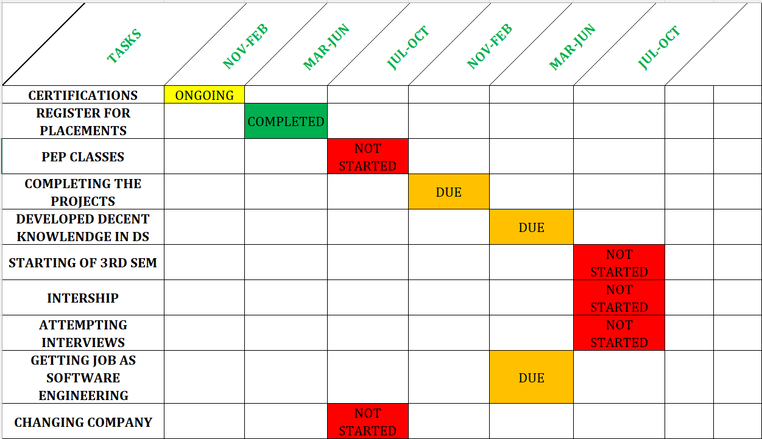
GANTT CHART

Slide 12
The End
Thanks

